Slide 1
Microcontroller Communication
Protocols
By
Akshita Gupta (BTBTE17143)
B.Tech ECE IV Year
Banasthali Vidyapith
(2017 - 2021)

Slide 2
Contents
Introduction
ATmega 16
Communication Protocols
Project Description
Result and Discussions
Future Scope
Conclusion
References
2

Slide 3
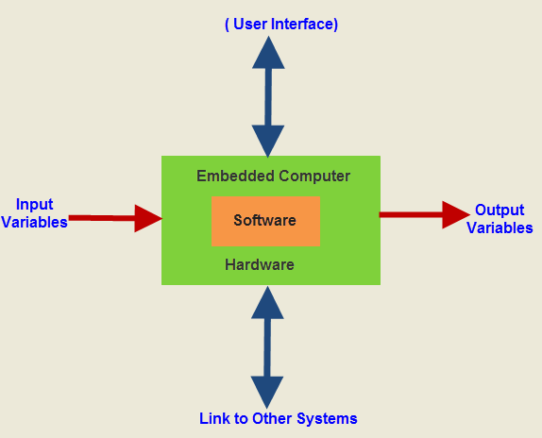
Introduction
The aim of this project is to define an RFID based security access control system.
Only authorized personnel allowed to access a secure area.
Passive RFID tag is used.
An embedded system is a kind of computer system mainly designed to perform several tasks.
3

Slide 4
ATmega 16
8 bit, 40 pin, high performance micro-controller of Atmel mega AVR family, low power consumption, based on RISC (Reduced Instruction Set Computing), instruction execution time 1 machine cycle, with frequency of 16 MHz.
16 Kb programmable flash memory.
Static RAM of 1 Kb and EEPROM of 512 bytes.
EEPROM with 10,000 to 100,000 write/erase cycle.
32 I/O lines divided into four 8 bit ports named as port A, port B, port C, port D.
Inbuilt peripherals USART, ADC , Analog comparator, SPI, etc.
4

Slide 5
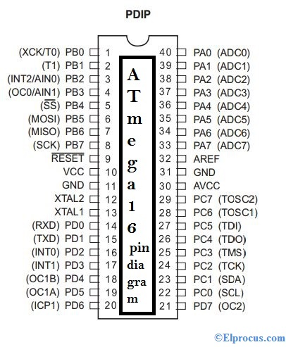
ATmega 16 (Pin Diagram)
PORT A
(Pin 33 - 40)
PORT B
(Pin 1 - 8)
PORT C
(Pin 22 - 29)
PORT D
(Pin 13 - 21)
PORT D
Pin 21

Slide 6
Communication Protocols
USART - The Universal Synchronous and Asynchronous serial Receiver and Transmitter (USART) is a highly flexible full duplex serial communication device. It needs data transmitter, receiver and clock generator to work and this way is often used in our daily life computer and TV connection, etc.
SPI - Serial Peripheral Interface is a full duplex synchronous serial communication interface specification characterized high-speed transmission. There is generally a host and multiple slaves work together. It uses two pin for data transfer, Serial Data Input (SDI) and Serial Data Output (SDO). It is used in sensors, camera lens control and data storage on SD cards.

Slide 7
Communication Protocols
I2C - The I2C (Inter-Integrated Circuit) is a bus interface connection incorporated into many devices such as sensors and EEPROM. It only needs two lines for communication, one is data line (SDA) and the other is clock line (SCL). Because this method only needs two wires, so this connection method is widely used, especially in some small products, such as household appliances, medical and so on.

Slide 8
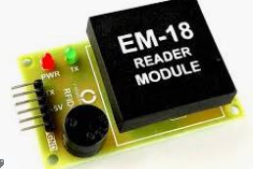
Project Description
The aim of this project is to design an RFID based security access control system.
RFID – Radio Frequency Identification Technique.
Wireless technology.
Authorization of personnel is carried out with an valid RFID card and only those with access can enter a secured area.
Passive RFID tag used.
Used to overcome security threats.
Comprise of RFID card and RFID reader module.
The most commonly used RFID reader is EM-18 reader module.

Slide 9
Project Description (Circuit Principle)
RFID card showed
THE COIL IN THE READER ENERGIES THE COIL IN THE RFID CARD THROUGH MUTUAL INDUCTION.
INFORMATION RECEIVED -
IF NO. FOUND IN CODE THEN SECURITY AREA OPENS.
IF NOT FOUND THEN ACCESS DENIED
COIL IN THE READER WORKS AS ANTENNA.
IT SEND INFORMATION IN MICROCHIP TO READER MODULE VIA RADIO COMMUNICATI ON VIA USART PROTOCOL
AS A RESULT, MICROCHIP IN THE READER ALSO GETS ENOUGH POWER TO TURN IT ON.
Mutual induction then radio communication.
Works as Antenna.

Slide 10
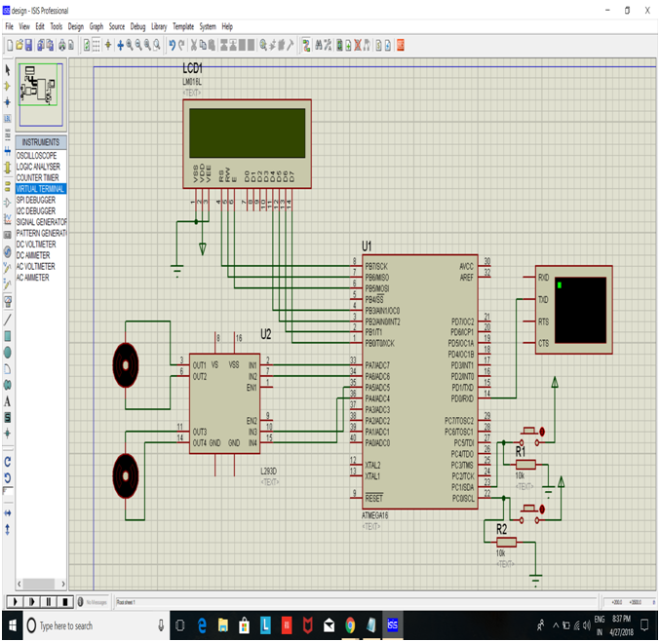
Project Description (Working)

Slide 11
Result and Discussions
Applications -
Used to automate sight spot ticket management system.
Used as personnel identification and individual or organization security.
Ability to read up to 10 meters is perfect for busy environments that need to maintain an element of security.
Pros -
RFID tags are able to handle easily which keeps employees from worrying about accidentally damaging their cards.
RFID tags can also function in almost any kind of weather, which is especially helpful for outdoor readers exposed to rain, snow, and extreme temperatures.

Slide 12
Result and Discussions
Cons -
RFID cards are prone to electromagnetic interference, which can come from other RFID cards or any other magnetized device. This means that they can easily be jammed or lose their ability to transmit information.
Though RFID systems are generally durable through adverse weather conditions and water, power outages that disable the door system can present a problem if no electricity backup is available.

Slide 13
Future Scope
A low cost RFID scanner can be manufactured and used which can scan multiple tags simultaneously for faster processing and lesser resources.
It can be used in ATM machines.
In malls for generating bills without standing in queue.
The card can be used to store information such as medical, biological and pharmaceutical records. It simplifies the process and enables doctors to have access to a more complete and comprehensive healthcare information.

Slide 14
Conclusion
The security concern for physical and intellectual property of any organization is a priority for the authorities. For this reason automatic identification and access control system has become necessary to overcome the security threats faced by many organizations.
This project is based on RFID Security Access Control System using ATmega16 Micro-controller and communication protocols such as USART, SPI, which is RFID Technology based security system
RFID Access Control System monitors security of door locks. This system also monitors illicit acts, for e.g., a person tries to enter when the door is open without completion of authentication process and sends a message on mobile phone through GSM.

Slide 15
References
Conference Technical Articles:
[1] U. Farooq et al., “RFID Based Security and Access Control System”, in IACSIT International Journal of Engineering and Technology, 2014, © IJET. Doi: 10.7763/IJET.2014.V6.718
[2] M. Salma and A.H. Alkeelani, “Locker Security System using keypad and RFID”, in the 2nd International Conference of Computer Science and Renewable Energies Morocco, 2019, © ICCSRE. Doi: 10.1109/ICCSRE.2019.8807588
Online Sources:
[3] https://www.getkisi.com/guides/rfid-access-control
[4] https://www.slideshare.net/avinashyada/rfid-based-security-access-control-system
[5] https://www.alldatasheet.com/datasheet-pdf/pdf/78532/ATMEL/ATMEGA16.html

